Slide 1
Juniper Internship Experience
Rui Han (2013 Summer Intern)
August 9, 2013

Slide 2
What I’ve done
Project A
Spotlight Solution Test
Project B
How Reverse Proxy Work
Workday Problem
Our Solution
Reproduce and Fixing
Conclusion

Slide 3
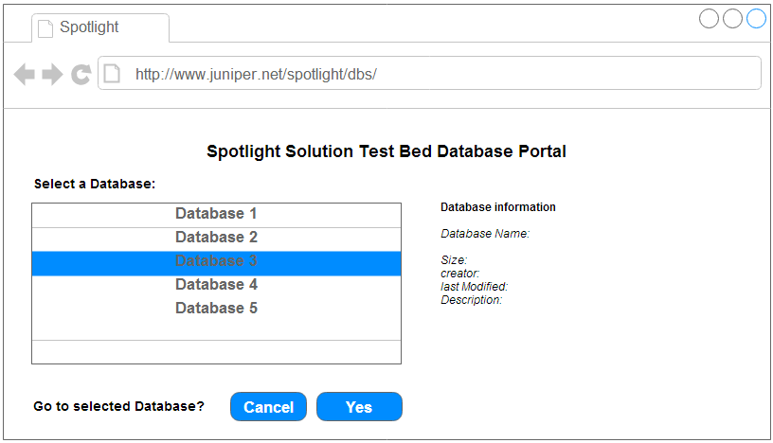
Project A
Objective: Create an interface to modify the Spotlight database contents

Slide 4
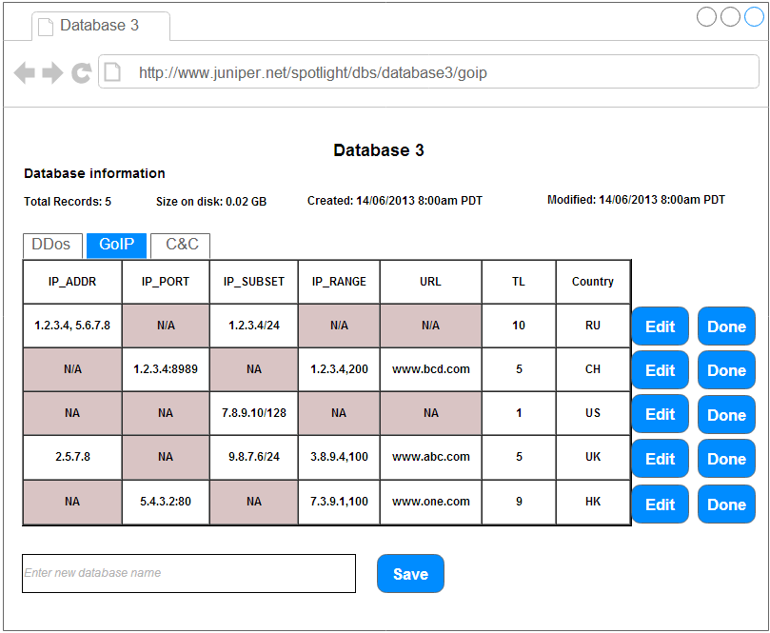
Project A
Objective: Create an interface to modify the Spotlight database contents

Slide 5
Challenges
Different object format of IP address (range, subnet, array of IPs, etc.)
Cause repetition of IP
How to efficient update
i.e. Update properties of one IP in an IP range
How to efficient search
How to avoid conflict

Slide 6
Things Learned in Project A
High level idea of SecIntel Project
Concept of NoSQL and MongoDB hands-on
Start programming Python
PyMongo Driver
Team work

Slide 7
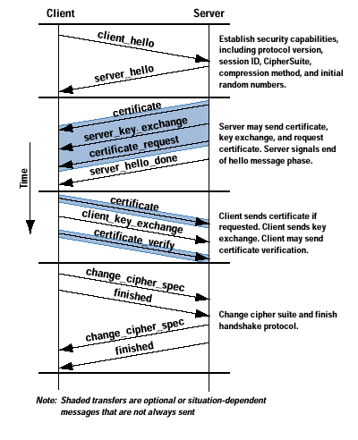
The Project B
SSL Reverse Proxy
Inspect SSL encrypted traffic (HTTPS)
if server’s private key is accessible.
Decrypt HTTPS traffic so the regular
IDP inspection can be applied
Does not terminate SSL session,
does not generate new packets
Support Key-exchange method:
RSA with fixed key
SRX
Encrypted data
Plain text

Slide 8
The implementation(Decryption)
Software
SSL RSA crypto operation is CPU intensive
RSA processing required during SSL handshake between client and server, is the bottleneck
RSA software APIs are not thread safe. It requires a global lock
Hardware
XLR chipset has built-in crypto engine
IDP SSL packet processing thread block the call to API
Test show the waiting time is very small
IDP SSL-inspection can process 1 Gbps of HTTPS traffic (512-bit)

Slide 9
Workday Issue
HTTPS Throughput(3DES-SHA, key size 1024Bit) with IDP Recommended Policy n 1NGSPC[3 flow spu] is 89% less than 1CGSPC[1.5 flow spu]
FPC performance monitoring show CPU usage is 99% in the rate of ~300 sessions/second for private key size of 1024-bit

Slide 10
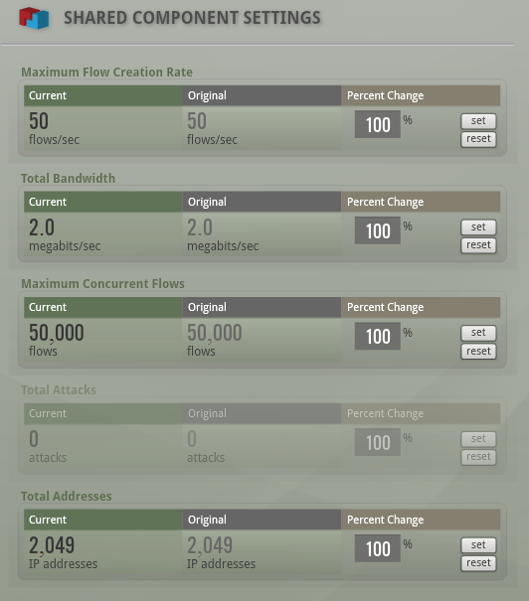
Investigate the SSL-Inspection
junos-srx1k3k-12.1I20130729_1810_ruihan-domestic.tgz
Traffic: BreakingPoint (idp-bps3)

Slide 11
Investigate the SSL-Inspection
junos-srx1k3k-12.1I20130729_1810_ruihan-domestic.tgz
Traffic: BreakingPoint (idp-bps3)
Case 1 (Server: 1024-bit RSA key):
Proxy key installation Scenarios:
matched 1024-bit RSA key,
unmatched 1024-bit RSA key,
2048-bit RSA key
Case 2 (Server: 2048-bit RSA key):
Proxy key installation Scenarios:
matched 2048-bit RSA key,
unmatched 2048-bit RSA key,
1024-bit RSA key

Slide 12
Case 1 SPU Performance
Two SPU card fpc 10 and fpc 7:
Monitoring the last 60 seconds using
> Show security idp monitoring performance spu
Unmatched 1024-bit key

Slide 13
Case 2 SPU Performance
Key size is 2048-bit
Key correct case: Sessions Not Decrypted = 0
Bad performance

Slide 14
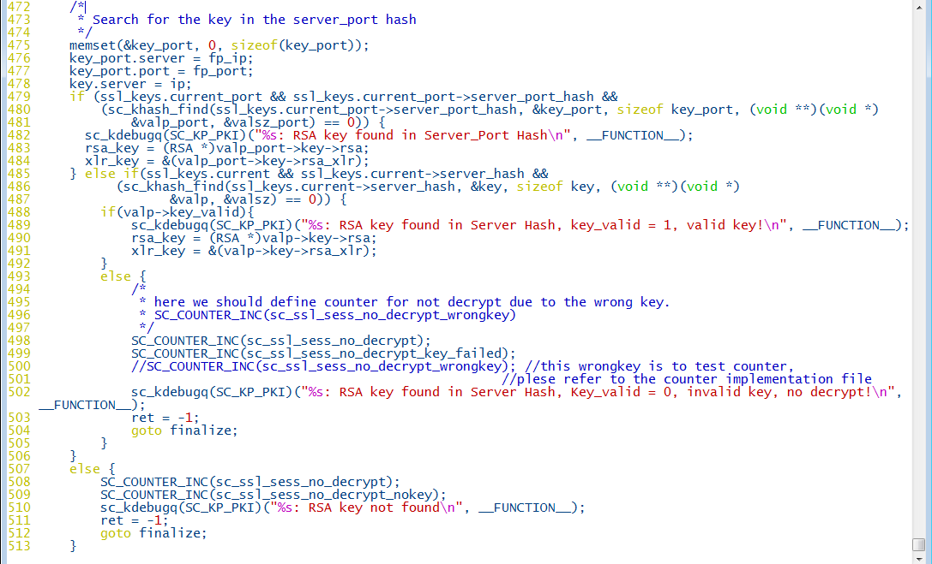
What Happened?

Slide 15
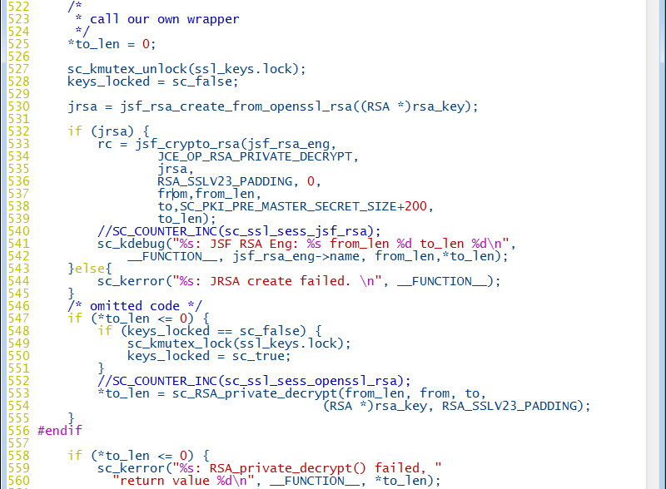
Solution to the Problem

Slide 16
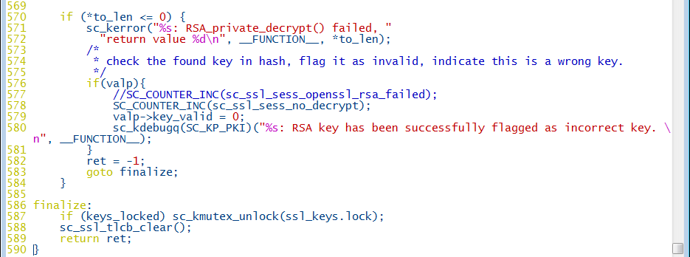
Solution to the Problem(cont.)

Slide 17

Verification
Sessions Not Decrypted - Installed Wrong Key
Sessions Used JSF CRYPTO for Key Decryption
Sessions - Error when JSF CRYPTO used
Sessions Used OPENSSL for key Decryption
Sessions - Error when OPENSSL used
Example 1: When matched key installed (ssl-inspection counters)

Slide 18

Verification
Sessions Not Decrypted - Installed Wrong Key
Sessions Used JSF CRYPTO for Key Decryption
Sessions - Error when JSF CRYPTO used
Sessions Used OPENSSL for key Decryption
Sessions - Error when OPENSSL used
Example 2: When mismatched key installed (ssl-inspection counters)

Slide 19
Testing Modified Image
junos-srx1k3k-12.1I20130802_2211_ruihan-domestic.tgz
Traffic: BreakingPoint (idp-bps3)
Case 1 (Server: 1024-bit RSA key):
Proxy key installation Scenarios:
matched 1024-bit RSA key,
unmatched 1024-bit RSA key,
2048-bit RSA key
Case 2 (Server: 2048-bit RSA key):
Proxy key installation Scenarios:
matched 2048-bit RSA key,
unmatched 2048-bit RSA key,
1024-bit RSA key

Slide 20
Case 1 SPU Performance
Two SPU card fpc 10 and fpc 7:
Monitoring the last 60 seconds using
> Show security idp monitoring performance spu
Key size is 1024-bit

Slide 21
Case 2 SPU Performance
Key size is 2048-bit
Key correct case: Sessions Not Decrypted = 0
Bad performance

Slide 22
Future Works
Detect mismatched key size
Effective solution that match PKI key pair
support key size larger than 1024-bit jsf crypto API (JSP-NGXLP)

Slide 23
Things I learned
Perfect software solution generalize to all use cases, both good and bad
“Love what you are working on”
“Focus on your goal”
“Success in any endeavor requires single-minded attention to detail and total concentration.”
by William Sutton
“Execution! Execution!! Execution!!!”

Slide 24
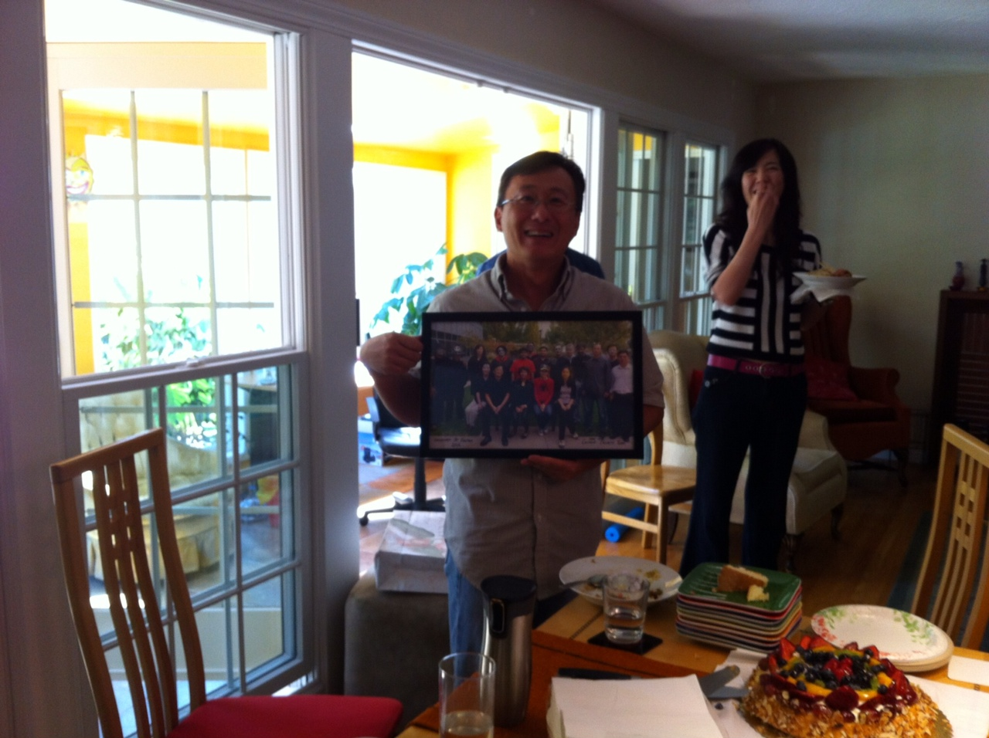
Farewell Party for Chris

Slide 25

Juniper SSD SBU Summer Picnic

Slide 26

Great American Gold Striker

Slide 27
Thank you all for making my internship
such a memorable experience.
Keep in touch!
iurnah@gmail.com
907-978-0826

Slide 28
Notes:
28

